Slide 1

MIA Pipeline – Registration I
Luca Sahli, Jacob Rasmussen and Camilo Mendez MIA-Lab Fall 2017

Slide 2
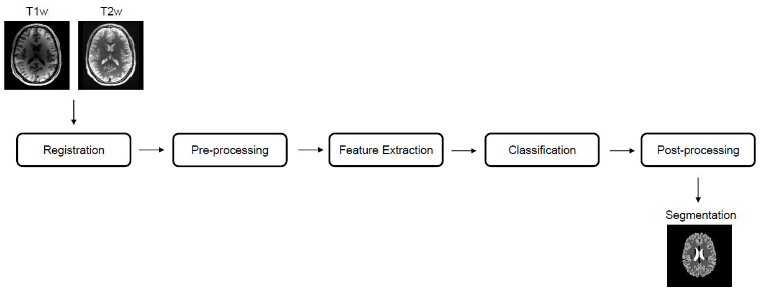
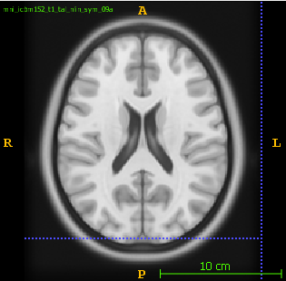
Introduction
Atlas space

Slide 3
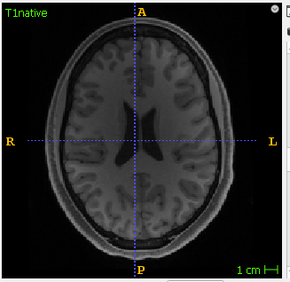
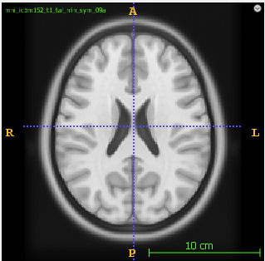
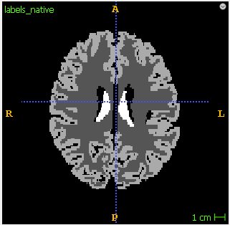
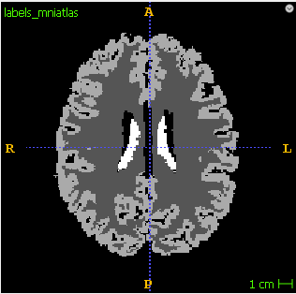
Methods - Evaluation
Affine
Registration
TAffine
T1_native
T1_atlas
TAffine
labels_registerd
labels_native
labels_registerd

Slide 4
Methods - Evaluation
Evaluator
Dice coefficients
..
..
..
..
labels_registerd
labels_mniatlas/
ground truth

Slide 5
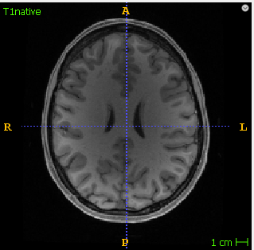
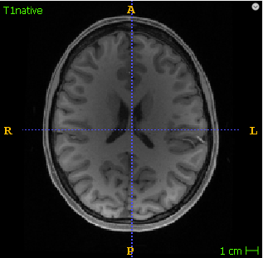
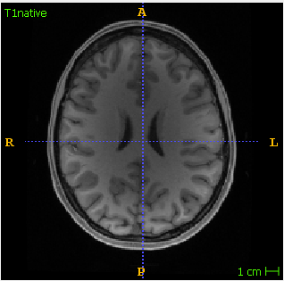
Methods - Testing
R.MultiModalRegistration()
Patient {1,2,3…,n}

Slide 6
Methods - Optimization
R.MultiModalRegistration()
def __init__(self, registration_type: RegistrationType=RegistrationType.AFFINE, #RegistrationType.RIGID, number_of_histogram_bins: int=200, learning_rate: float=1.0, step_size: float=0.001, number_of_iterations: int=200, relaxation_factor: float=0.5, shrink_factors: [int]=(2, 1, 1), smoothing_sigmas: [float]=(2, 1, 0), sampling_percentage: float=0.2):

Slide 7
Results on different patients

Slide 8
Results – Bin optimation

Slide 9
Further steps
Test more parameters
T2 in place of T1

